Slide 1
编译原理 Principle of Compilers
Haodi Zhang

Slide 2
Evaluation (Tentative)
平时40%
平时10%
实验30%：
6个实验，每个实验5%
实验报告、实验presentation、实验运行
期末60%
大概分布：
概论与文法15%、词法20%、语法50%、翻译15%

Slide 3
Overview
Concept
Participants
Typical Tasks
What
Motivation
Applications
Why
Key Problems
Methods
Limitations
How

Slide 4
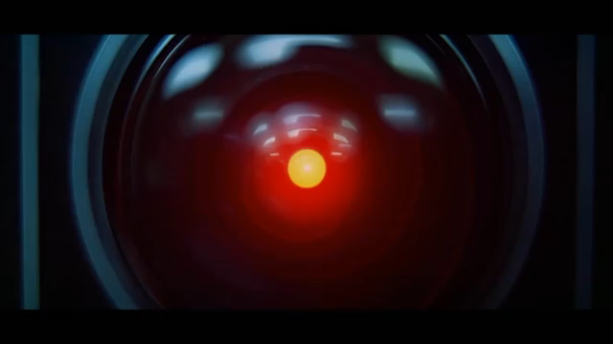
Motivation
2001: A Space Odyssey
Reference: 培根悖论扯夜场15《2001：太空漫游》
Notes:
First Coupon question:
which movie is this segment from?

Slide 5
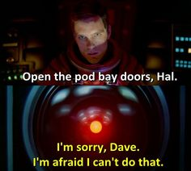
Motivation
“2001: A space Odyssey”
By Stanley Kubrick 1968
Written by Arthur C. Clarke
Natural language processing (NLP) is a study of the computational treatment of human natural language.

Slide 6
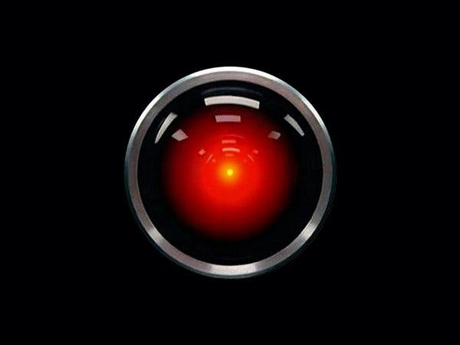
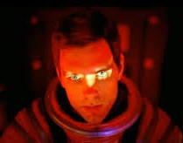
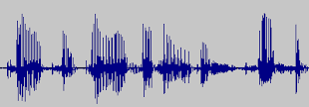
Motivation
Natural Language Generation
Speech Synthesis
Semantics/
Meaning
Symbolic
Representation
Acoustic Signal
“I’m sorry, Dave. I’m afraid I can’t do that.”
“Open the pod bay door, HAL”
Artificial Intelligence Core
Reasoning
Planning
Solving Problems…
Natural Language Understanding
Semantics/
Meaning
Speech Recognition
Symbolic
Representation
Acoustic Signal
Text
Embedding
…

Slide 7


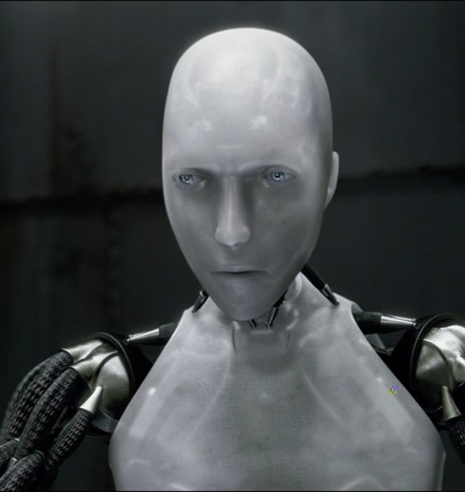
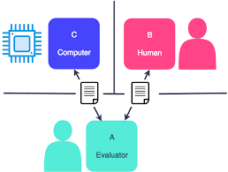
Motivation
“2001: A space Odyssey”
By Stanley Kubrick 1968
Written by Arthur C. Clarke
The Terminator, 1984
I, Robot, 2004
Ex Machina, 2015
……
Turing Test
A computer can be said to possess artificial intelligence if it can mimic human responses under specific conditions.
Natural language processing (NLP) is a study of the computational treatment of human natural language.
Notes:
COUPON Question 2: What is Turing Test?

Slide 8
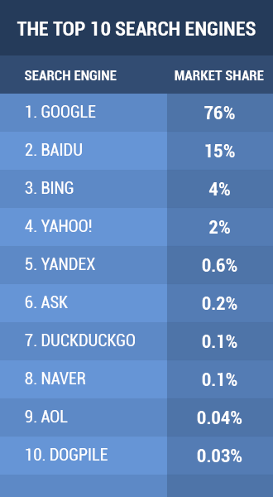

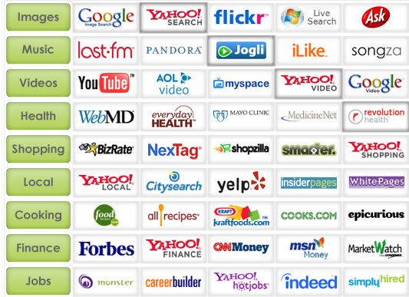
What is NLP: examples
Searching

Slide 9
What is NLP: examples
Searching
Machine Translation
Google Translate, Baidu Fanyi, etc.
Voice Assistant/Smart Speaker
Amazon Alexa, Google Assistant, Apple Siri, Microsoft Cortana, Samsung Bixby, Baidu Xiaodu, etc.
Speech Recognition/Synthesis, Question Answering (IBM Watson)
Chatbot
News Digest
Yahoo!
Marketing
Sentiment Analysis, Advertising, etc.

Slide 10
What is NLP: definitions
Natural language processing (NLP) is a study of the computational treatment of human natural language.
Natural language processing (NLP) is a subfield of linguistics, computer science, information engineering, and artificial intelligence concerned with the interactions between computers and human (natural) languages, in particular how to program computers to process and analyze large amounts of natural language data.

Slide 11



Motivation
Human
Human Languages
How can human beings interact with machines?
Computer
Executable
Codes
Tasks
Able to Understand
Able to Act
Notes:
Coupon Questions: How can human beings interact with machines?

Slide 12
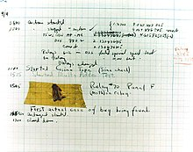
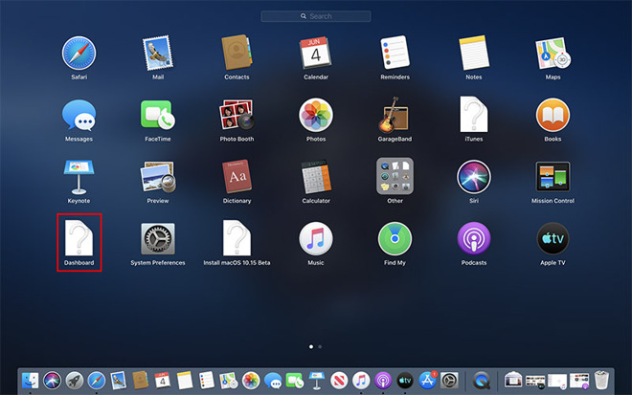
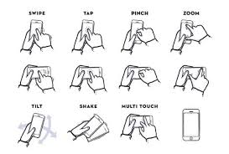

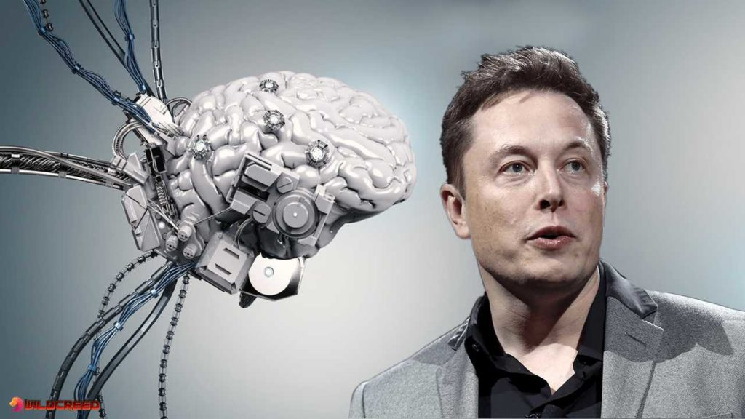
Human-Machine Interaction
Text based: Programs
Visual based:
Graphic User Interface
Gesture User Interface
Audio based:
Voice Interface
Other signal-based

Slide 13
Communication
Speaker
Intention （立意）
Generation （组织）
Synthesis （发表）
Listener
Perception （感知）
Interpretation （分析）
Incorporation （理解）
Mind
语言系统
语法Syntax
语义Semantic
Semantic
Syntax
Signal
Signal
Syntax
Semantic
Mind
Notes:
Incorporation: 或 Internalization

Slide 14
Communication
Intention
Generation
Synthesis
Semantics/
Meaning
Symbolic
Representation
Acoustic Signal
Speaker
“I’m sorry, Dave. I’m afraid I can’t do that.”
“Open the pod bay door, HAL”
Listener
Semantics/
Meaning
Symbolic
Representation
Acoustic Signal
Text
Embedding
…
Incorporation
Interpretation
Perception

Slide 15
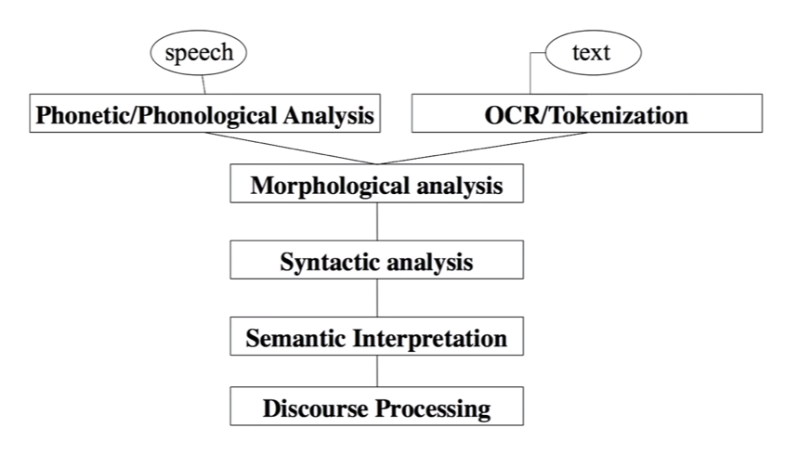
NLP: How

Slide 16
编程语言 vs. 自然语言
Programming Languages are
Well defined
Unambiguous
Mostly context-free or context-sensitive
Limited tasks
Natural languages are usually ambiguous
Exception: Lojban
Ambiguous word: fly, rent, tape, plant, branch, …
NLP is very difficult for Machines

Slide 17
Ambiguity
Los Angeles Police shoot man Holding box cutter
Children make delicious snacks
Fried Chicken makes delicious snacks
Stolen wallet is found by tree
Stolen wallet is found by Mac
Trump wins on budget, more lies ahead
震惊！洛城警察射杀持刀男子
震惊！洛城警察持刀射杀男子

Slide 18
Ambiguity from context
语境：He is an unbelievable worker
Extremely good vs. Not trustful
背景知识：
中国 大败 德国
Chinese Ping Pong Beats Germany
中国 大败 德国
Chinese Football Beaten by Germany
女乒
男足

Slide 19
Contextual interpret.
Beverley Hills
Beverley Sills
John and Ross are fathers
John and Ross are brothers
Every American has a mother
Every American has a president
Give the bananas to the monkeys, because they are hungry
Give the bananas to the monkeys, because they are over-ripe
The book does not fit the bag, because it is too big
The book does not fit the bag, because it is too small

Slide 20
Syntax and Semantics
Beautiful a has Monica Flower.
研表究明，汉字的序顺不定一能影阅响读，比如当你看了完这句话，才发这现里的字全是都乱的。
Colorless green ideas sleep furiously.

Slide 21
NLP: How
Much more complex and difficult than Compiling!
Almost well defined
Invariant across multiple encodings: sound, gesture, images
Includes not only discrete symbols, but also Continuous signals of sound or vision
Large vocabulary (Machine learning encoding problem: sparsity)
Ambiguous
At least Type-0
Variety of tasks in complex context
AI Approaches

Slide 22
Motivation
Human
Human Languages
Programming Languages
Compiler
Computer
How?
Executable
Codes
Tasks
Able to Understand
Able to Act

Slide 23
Programming Languages
Level
High-level languages: C++, Java, Python, etc.
Assembly languages
Machine code
Formulation
Procedural Programming Language
Functional Programming Language
Object-oriented Programming Language
Declarative Programming Language
Others, such as Scripting
Notes:
Online Logic Programming:
https://potassco.org/clingo/run/

Slide 24
What
编译原理是计算机专业的一门重要专业课，旨在介绍编译程序构造的一般原理和基本方法。
内容包括
语言和文法：
词法分析：
语法分析：
语法制导翻译：
语义分析与中间代码生成、存储管理等
如何定义一个语言？包括其单词、句子
如何准确、快速识别出符合定义的单词
如何准确、快速识别出符合定义的句子
如何将源代码翻译成中间代码

Slide 25
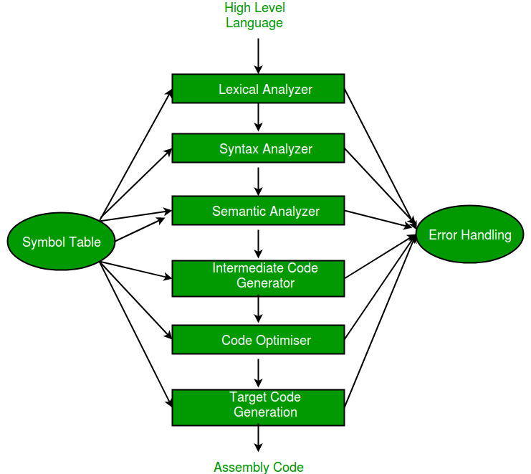
NLP: How
Compiler

Slide 26

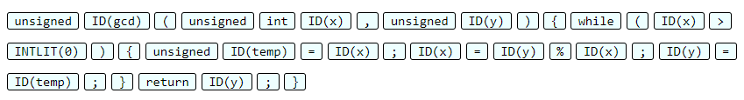
NLP: How
Compiler
Lexical Analyzer
#define ZERO 0
// Euclid’s algorithm
unsigned gcd (unsigned int x, unsigned y) {
while ( /* hello */ x > ZERO ){
unsigned temp=x;
x = y % x;
y = temp;}
return y ;}

Slide 27
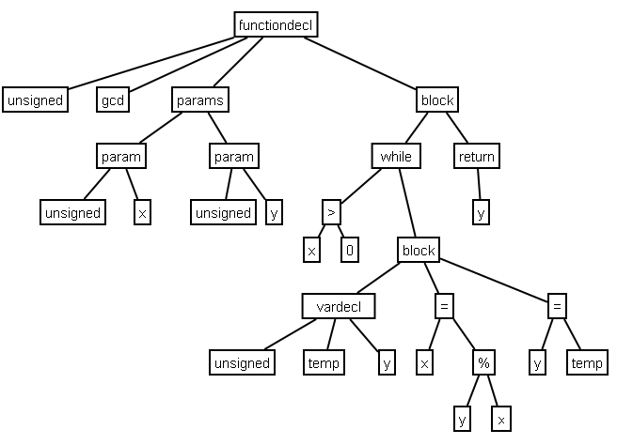
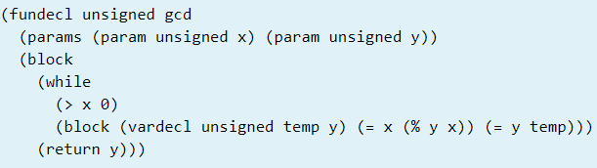
NLP: How
Compiler
Syntax Analyzer (Parser)

Slide 28
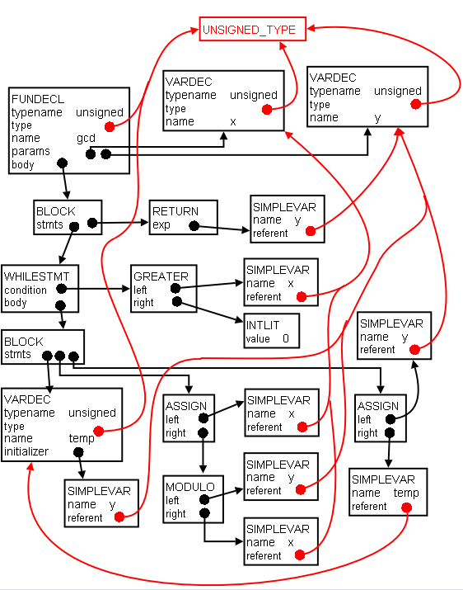
NLP: How
Compiler
Semantic Analysis

Slide 29
NLP: How
Compiler
Intermediate Code Generation
Code Optimization
Machine Independent
Machine Dependent
Target Code Generation

Slide 30
Why
Theoretically：
什么是可计算，什么是不可计算？
可计算里面，什么是P问题，什么是NP问题？
形式语言与自动机理论
Practically：
新型编译器设计：直接改进、应用
算法设计、安全验证等：自动机应用
文本处理：源代码就是文本，处理文本的技术可通用
数据交换：网络上传输的很多数据，序列化之后，就是普通的文本数据

Slide 31
Why
Generally：
培养全面、严谨、高效的计算思维与求解实现能力
本质上，任何计算机问题的求解过程，都可转化为语言的转换、翻译问题。
机器指令
实验实现
现实问题
观察/思考
计算方法
程设语言
问题描述
书面语言
表示模型
数学语言

Slide 32
Why
In AI era：？？
机器指令
实验实现
现实问题
观察/思考
计算方法
程设语言
问题描述
书面语言
表示模型
数学语言

